Slide 1
Architecture
Notes:
Good afternoon everyone!
Thank you for joining the Baselines and Benchmark Webinar.

Slide 2
Why HPCC (or any other Big Data platform)?
Notes:
Let us review a few examples of data problems and potential solutions

Slide 3
To Solve The Dirty Data Problem
Notes:
Let us review a few examples of data problems and potential solutions

Slide 4
Examples of Dirty Data
Not Clean – e.g. Incorrect spelling, Incorrect Age Range
Misclassified Data – e.g. Incorrect Gender Classification (Male vs. Female)
Missing Values – e.g. missing state or city in an address
Has Duplication – e.g. repeating customer names
High Noise Levels – e.g. data that is not relevant to the current problem
Notes:
For starters, let us review some of common data problems
Unclean data like Incorrect spelling, Incorrect Age Range
Misclassified Data like Incorrect Gender Classification (Male vs. Female)
Missing Values like city or state in an address
Duplication like repeating customer names
Data noise, where, data that is not used to solve the problem is recorded
Extracting of data from Complex content like HTML documents
How do we deal with Terabytes of data. Redundancy, Disaster Recovery etc.
Many sources – Subsidiary companies, CRM, ERP systems, Product systems, Logs etc.
Complex technology solutions – Hadoop, Spark, HPCC etc.
Do you agree?

Slide 5
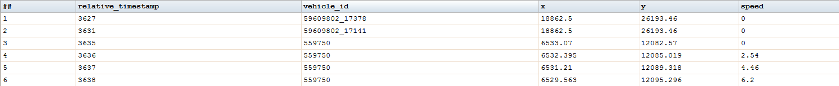
Vehicle Telematics Data – Cologne Germany
Input
Pattern | Count
99.99 | 182,861,502
9.99 | 75,683,713
99.9 | 20,458,456
99999.999999999999 | 1
HPCC Data Profile
718,141 unique Vehicles
Summary Report
There are a few records with blank y values
Record Count
354,358,979
Recognized as a string. Expected to be a real8. Data is not clean
Column Report
Column | Input Type | Fill Rate | Fill Count | Cardinality | Output Type
relative timestamp | string | 100 | 354,358,979 | 82387 | unsigned3
vehicle id | string | 100 | 354,358,979 | 718,141 | string19
x | string | 100 | 354,358,979 | 150,338,677 | real8
y | string | 99.999999 | 354,358,977 | 150,340,639 | string32
speed | string | 100 | 354,358,979 | 6993 | string19
Indicates a speed >= 1000 meters/second
Notes:
Let us see how data profiling can be useful.
We recently concluded a hackathon where we used simulated telematics data
The simulation was performed over a duration of 24 hours
Simulating traffic in Cologne Germany
With 1000s of vehicles
At a 1 second rate
The data contained 5 attributes – relative time, vehicle id, x & y (in meters) and speed (in meters per second)
When we run the built in HPCC Systems profiler on the data, the partial report shows:
Total Records
For each column in the data, the Fill Rate, Fill Count, Cardinality, Best Type
Data Patterns for each field
From this we can deduce:
We are dealing with around Seven Hundred Thousand Vehicles
There are missing Values for the Y attribute in two records
There are unexpected Type Values for the Y and Speed columns in some records
There is an incorrect Speed value in one record
I hope the example shows why data profiling is very important.

Slide 6
MATCH — the system has learnt that “Villanustre” is specific because the frequency of occurrence is small and there is only one present in Atlanta
CORRECT
Flavio Villanustre, Atlanta
Javio Villanustre, Atlanta
Eliminate FALSE NEGATIVES
NO MATCH — because the rules determine that “Flavio“ and “Javio” are not the same
ERROR
INPUT
OUTPUT
John Smith, Atlanta
John Smith, Atlanta
MATCH — because the rules determine that “John Smith“ and the city for both the records match
Eliminate FALSE POSITIVES
ERROR
NO MATCH — the system has learnt that “John Smith” is not specific because the frequency of occurrence is large and there are many present in Atlanta
CORRECT
Notes:
If you were literally matching Flavio Villanustre, Atlanta to Javio Villanustre, Atlanta
Your result would be a No Match
The correct result is that, it is a match because there is only one Flavio Villanustre in the US and in Atlanta. Knowing the specificity of the name before the matching is executed is very important.
Conversely, there are too many John Smiths in the Atlanta area.
So the correct answer for the second example would be that it is not a match

Slide 7
Well, we can solve this using ETL tools and an RDBMS
Notes:
Well, we have a slightly different perspective

Slide 8
Big Data as a solution
Problems
Solutions
Not Clean
Misclassified Data
Missing Values
Has Duplication
High Noise Levels
Not Clean
Misclassified Data
Missing Values
Has Duplication
High Noise Levels
Many Sources
Big Data
Purpose Built Technology
Notes:
While we agree that some of them are clearly problems, others are actually the solution.
For example, ingesting data from multiple sources might be a good thing.
It might help in the currency of the data and eliminate inaccuracies
Let us consider an example:
The case where a customers contact information is populated from 3 sources.
So what is the correct address?
Maybe all of them?
Maybe the latest recorded address?
Maybe the one recorded by the most reliable of the sources.
So you have more choices to make the decision.
If you had relied on one source, you would have to stick with it even if it incorrect.
In addition, we can infer more information from multiple sources. For example, we could infer the migration path of the customer based on the his address change and time.

Slide 9
Record | First Name | Last Name | Address | City | State | Zip
1 | MARCIA | MARSUPIAL | 6035 JONES ST | ARVADA | CO | 80004
2 | KAREN | KANGAROO | 5865 W OHIO AVE | LAKEWOOD | CO | 80226
Are they the same person?
Match
Source 1
@ time N
MARCIA | K | MARSUPIAL | 6035 |  | JONES | ST | ARVADA | CO | 80004
Moved
Source 1
@ time N + 1
MARCIA | K | MARSUPIAL | 9170 | W | 14TH | AVE | LAKEWOOD | CO | 80226
Changed Last Name
Source 2
@ time N + 2
MARCIA | K | KANGAROO | 9170 | W | 14TH | AVE | LAKEWOOD | CO | 80226
Used Middle Initial
Source 3
@ time N + 2
K | MARCIA | KANGAROO | 9170 | W | 14TH | AVE | LAKEWOOD | CO | 80226
Match
Source 1
@ time N + 3
KAREN | MARCIA | KANGAROO | 5865 | W | OHIO | AVE | LAKEWOOD | CO | 80226
Notes:
Are Mar-cia Mar-su-pial and Karen Kangaroo the same person?

Slide 10
Person Attributes
Record | First Name | Last Name | Address Count | Vehicles | DUI | Bankruptcy
1 | MARCIA | MARSUPIAL | 3 | 2 | 0 | 0
Person First Degree Relatives
Record | First Name | Last Name | Relative
1 | SARAH | MARSUPIAL | DAUGHTER
2 | JOHN | MARSUPIAL | SON
3 | MARK | MARSUPIAL | HUSBAND
Person Vehicles
Record | Make | Model | Year
1 | NISSAN | ALTIMA | 2001
2 | AUDI | Q5 | 2005

Slide 11
The Data Maturity Process
Notes:
The Data Maturity Process is used to convert raw data into intelligent data
Where, the intelligent data is used enable end user decisions
In HPCC Systems, the Data Maturity Process has three workflow steps

Slide 12
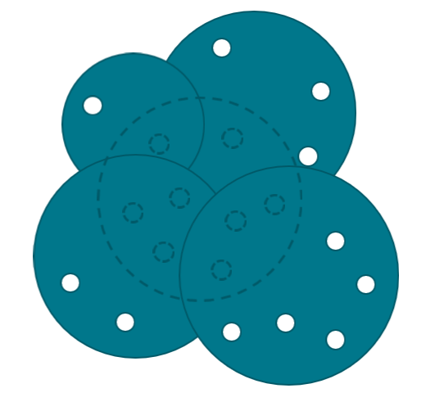
A single source of data is insufficient to overcome inaccuracies in the data
HPCC Systems is built on the premise of absorbing data from many data sources and transforming them to smart data (actionable)
Notes:
The Collect step involves collecting data from as many sources as we can. Even the same data from a different data source.
Why do we do this?
Because data from one source can tend to contain inaccuracies – “The holes in the data”
Combining data from multiple sources will enhance the data and remove these holes.
This was also shown in the earlier example.

Slide 13
2: LEARN Step
Raw Data
Profile -> Clean -> Standardize
Enhance -> Dedupe -> Relate
Rich Connected Data
Notes:
The Learn step is where the data is:
Profiled, Cleaned and Standardized.
Enhanced, Deduped and Related.
An example of Enhancing the data would be to add a calculated date field that did not exist in the original data
An example of Relating is to associate two company records because one is a subsidiary of the other
Hence, creating a rich connected data graph

Slide 14
3: DECISION Step (Real-time or Batch)
INPUT: Disjointed Connections
Query Graph
OUPUT: Rich Connections
Notes:
The decision step is about accepting inquiry data and providing results (Real-time or batch)
The decision step heavily relies on the data that has been learnt from the LEARN step
We will see a few use cases related to this later in the presentation

Slide 15
HPCC Systems Architecture
Notes:
The Data Maturity Process is used to convert raw data into intelligent data
Where, the intelligent data is used enable end user decisions
In HPCC Systems, the Data Maturity Process has three workflow steps

Slide 16
COLLECT
Batch
Real-time/Stream
Big Data
Structured
Unstructured
Semi-structured
Landing Zone (s)
Thor cluster(s)
Job Execution
ROXIE cluster (s)
Real-time API
Developer
Using VS Code ECL
Middleware Services
HPCC Data Lake System
Notes:
HPCC has two cluster components Thor and ROXIE
Thor is specifically architected to accomplish the LEARN step
Thor is the batch oriented system, that is similar in functionality to Spark
Thor can scale from a single node to 1000s of nodes.
In contrast to Thor, ROXIE is designed to accomplish the DECISION step
ROXIE provides a real-time interface
Similar to Thor, ROXIE can run scale from one to 100s of nodes
Both Thor and ROXIE are programmed using ECL, an open language for data processing.
We will cover more on ECL later in the presentation.

Slide 17

Thor
Big Data
Structured
Unstructured
Semi-structured
Thor cluster
Batch Data Cluster
ECL
Middleware Services
Developer
Using VS Code ECL

Slide 18
ROXIE
Applications &
BI Tools
Big Data
Structured
Unstructured
Semi-structured
Thor cluster
Batch Data Cluster
ROXIE cluster
Real-time Query Cluster
ECL
Middleware Services
Developer
Using VS Code ECL

Slide 19
4 Partitions of
2 Records each
8 Input Records
Processing Workers
#1 ----- ------ ------
#2 ----- ------ ------
#1 ----- ------ ------
#2 ----- ------ ------
Worker 1
#3 ----- ------ ------
#4 ----- ------ ------
#3 ----- ------ ------
#4 ----- ------ ------
Worker 2
#5 ----- ------ ------
#6 ----- ------ ------
#5 ----- ------ ------
#6 ----- ------ ------
Worker 3
#7 ----- ------ ------
#8 ----- ------ ------
#7 ----- ------ ------
#8 ----- ------ ------
Worker 4
Notes:
In this simple example, a single data file is broken down to 4 partitions
Why?
Because there are four processes (or executors) available to process this data.

Slide 20
Thor Cluster

Slide 21
A Multi Server Instance Configuration
N
E
TWO
R
K
Landing Zone Server 1
Server Instances
File Service
Landing Zone Server 2
File Service
Worker 1 Process
File Service
DFU Server
Thor Cluster 1
Worker 2 Process
File Service
Dali Process
Worker 3 Process
File Service
Sasha Process
Worker 4 Process
File Service
ECL Agent
Manager Process
ECLCC Server
Thor Cluster 2
ESP Server
Middleware Services

Slide 22
Manager Process
Coordinates Worker Processes
Worker – Process a data partition
Worker Process
File Service
File Service – Work with the DFU Server
ESP Server
ECL Watch and SOAP/REST services
DFU Server
Spraying and Despraying service
Dali Process
File Metadata Store, Workunit Store
Sasha Process
Workunit Archive Store
ECL Agent
Submits ECL Job to a cluster
ECLCC Server
ECL Compiler

Slide 23
ESP Server
Management console and API
DFU Server
Data importing and exporting service
Dali Process
File metadata store, program result store
Sasha Process
Program archive store
ECL Agent
Accept and process program requests
ECLCC Server
ECL Compiler

Slide 24
Manager Process
Coordinates Slave Processes
Worker Process
File Service
Executes code on a data partition
ESP Server
ECL Watch and SOAP/REST services
DFU Server
Spraying and Despraying service
Dali Process
File Metadata Store, Workunit Store
Sasha Process
Workunit Archive Store
ECL Agent
Submits ECL Job to a cluster
ECLCC Server
ECL Compiler

Slide 25
A Single Server Instance Configuration
STORAGE
N
E
TWO
R
K
ESP Server
ECLCC Server
ECL Agent
Sasha Server
DFU Server
Dali Process
File Service
Worker 1 Process
Worker 2 Process
Worker 3 Process
Worker 4 Process
Manager Process
Notes:
Thor is based on a Master and Slave architecture
Each Thor Slave process is responsible for processing a data partition
Data on Thor is partitioned by the number of available Slave processes
The Master process acts as a coordinator for the Slave processes
Dali is the metadata server and is equivalent to the name node
DFU server is responsible for importing data files and partitioning
Thor can run on a single server or multiple server configuration as shown

Slide 26

Thor Manager
25,000 records
Worker 1
25,000 records
Worker 2
100K
Records File
25,000 records
Worker 3
25,000 records
Worker 4
Physical File (maybe on Landing Zone)
Logical File (divided across Thor Workers)

Slide 27
Thor
ROXIE
1) File Spray
3) Data and Query Deploy
Thor Manager
ROXIE Node
Landing Zone
25,000 records
Worker 1
50,000 records
25,000 records
Worker 2
100K
Records File
Worker 1
Server 1
25,000 records
Worker 3
50,000 records
25,000 records
Worker 4
Worker 2
Server 2
Physical File
Logical File
(divided across Workers)
ECL
Program
2)

Slide 28
3. ECL Code is compiled to C++ and then a DLL
DALI
ECLCC Server
4. Store DLL into workunit
2. Create a workunit and store code
5. ECL Agent gets DLL from workunit
1. Submit ECL Code
ESP
9. Write Results to workunit
ECL Agent
10. View Results
6. Send DLL to the target for execution
8. Results of program execution
NOTE: workunit = A DALI record that stores a programs execution profile
7. Program is executed by Thor
Thor Clusters

Slide 29
ROXIE Cluster

Slide 30
ROXIE Node
25,000 records
Thor cluster
25,000 records
API Calls
25,000 records
Raw data records
100K Records
Data and Code Deploy
25,000 records
Logical File
Physical File (maybe on Landing Zone)
Worker
Server

Slide 31
Thor
ROXIE
Data and Query Deploy
Thor Manager
ROXIE Node
25,000 records
Worker 1
50,000 records
25,000 records
Worker 2
100K
Records File
Worker 1
Server 1
25,000 records
Worker 3
50,000 records
25,000 records
Worker 4
Worker 2
Server 2
Physical File
(maybe on Landing Zone)
Logical File
(divided across Workers)

Slide 32
N
E
TWO
R
K
Roxie Process 1
Server
Worker
Roxie Process 2
Server
Worker
Roxie Process N
Server
Worker
Notes:
ROXIE is based on peer to peer architecture
ROXIE is a REST/SOAP service provider
ROXIE has two components – A Server and a Worker
Just like in a Thor Slave, the Worker is responsible for a partition of a data file
The ROXIE Server component is responsible for processing the client request and coordinating with the Workers

Slide 33
Roxie Process
User coded programs that are compiled into a data flow execution graph and data marshalling code for each step in the data flow
Program DLL
Server
Responsible for receiving client requests, interpreting the programs data flow, retrieving data from a slave, calling the program DLL for executing a data flow step and returning the results to the client
Worker
Responsible for fetching data from a data partition at the request of the Server

Slide 34
ECL Program
Syntax Check
Parsing
Semantic Check
Data Flow Graph Generation
Optimization
C++ Code Generation for each Activity Step
Compilation (DLL)
Deploy to Container (Thor or Roxie)

Slide 35
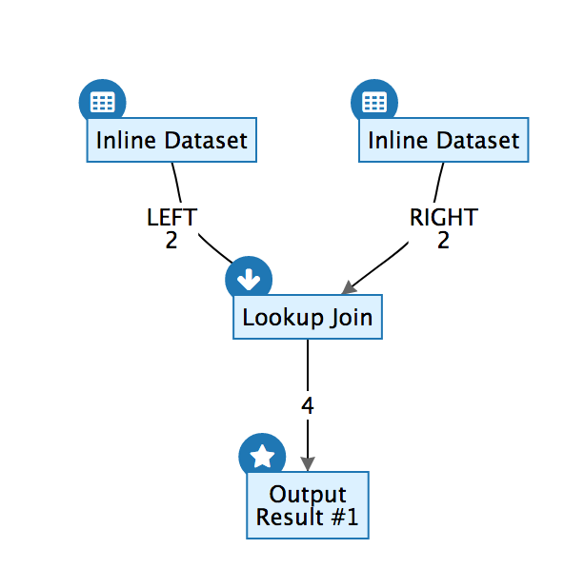
Activity 1
Read Employee Data
Activity 2 Read Salary Data
Data Flow 2 records flow from Activity 1 to 3
Data Flow 2 records flow from Activity 2 to 3
Activity 3 Use the output of Activity 1 and 2 and perform a JOIN
Data Flow 4 records flow from Activity 3 to 4
Activity 4 Use the output of Activity 3 and perform an OUTPUT

Slide 36
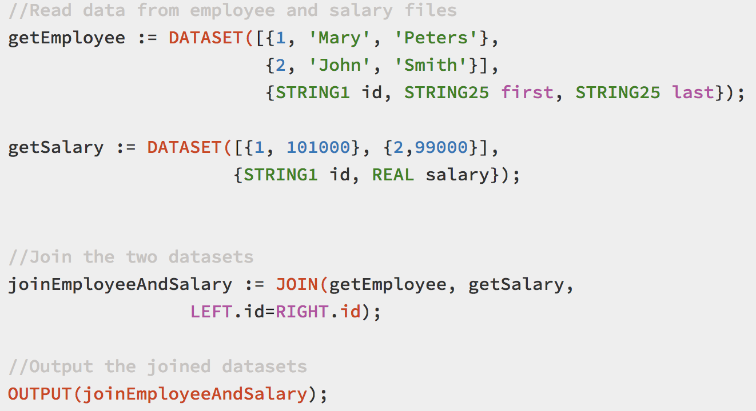
Declare a data read Activity and name it getEmployee
Declare a data read Activity and name it getSalary
Declare a JOIN Activity and name it joinEmployeeAndSalary
Declare an OUTPUT activity

Slide 37
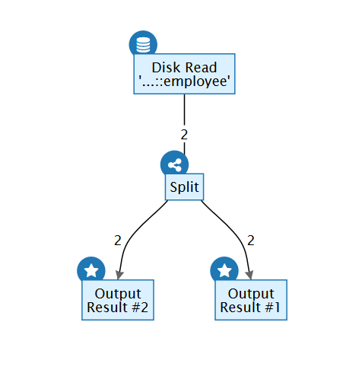
Activity 1
Read Employee Data Once
Activity 2
Optimized to Split
Activity 3
Output
Activity 4
Output

Slide 38
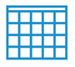
Dali
Workunit DB
Queue Server
ECLCC Queue
Agent Queue
Thor Queue
7
9
10
2
8
Thor Cluster
4
6
5
11
ESP
ECLCC Server
ECL Agent
Manager
Slave
Slave
Slave
Worker
1

Slide 39
Dali
ESP
2
3
4
1
Dali Service
ECLCC Server
ECLCC Queue
5
Client (e.g. VS Code)
Agent Executor
6
7
ECL Agent
Agent Queue
ECL Agent
ECL Agent
8a
8b
9
Thor Manager
Thor Queue
Slave
Slave
Slave
10
Worker
Workunit DB
Thor Cluster(s)

Slide 40
Dali
A-1
ESP
A-2
A-3
A-4
Dali Service
ECLCC Server
ECLCC Queue
A-5
A-6
A-7
Roxie
A-8
Client
Workunit DB
API Calls
B-1
B-2
A-9
B-3
Thor Manager
Slave
Slave
Slave
Worker
Thor Cluster

Slide 41
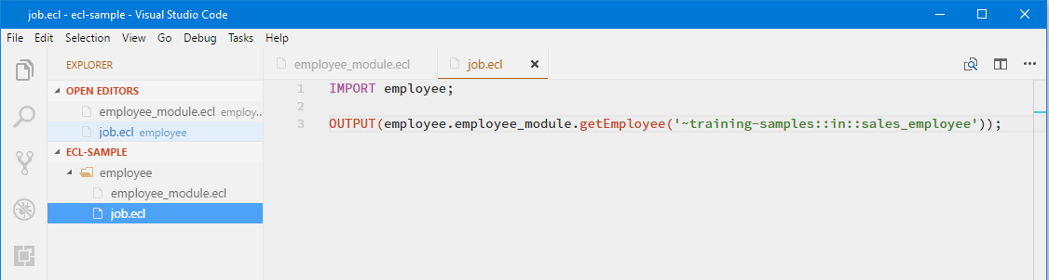
Fully qualify – <dir>.<module>.xyz
Project root
Import the Package
Package

Slide 42
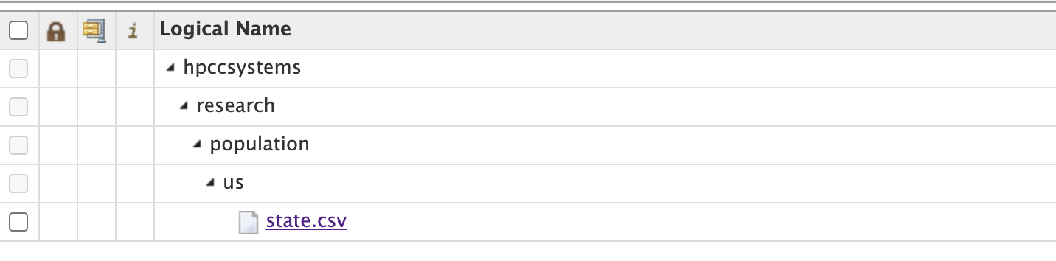
File Scope
File Name

Slide 43
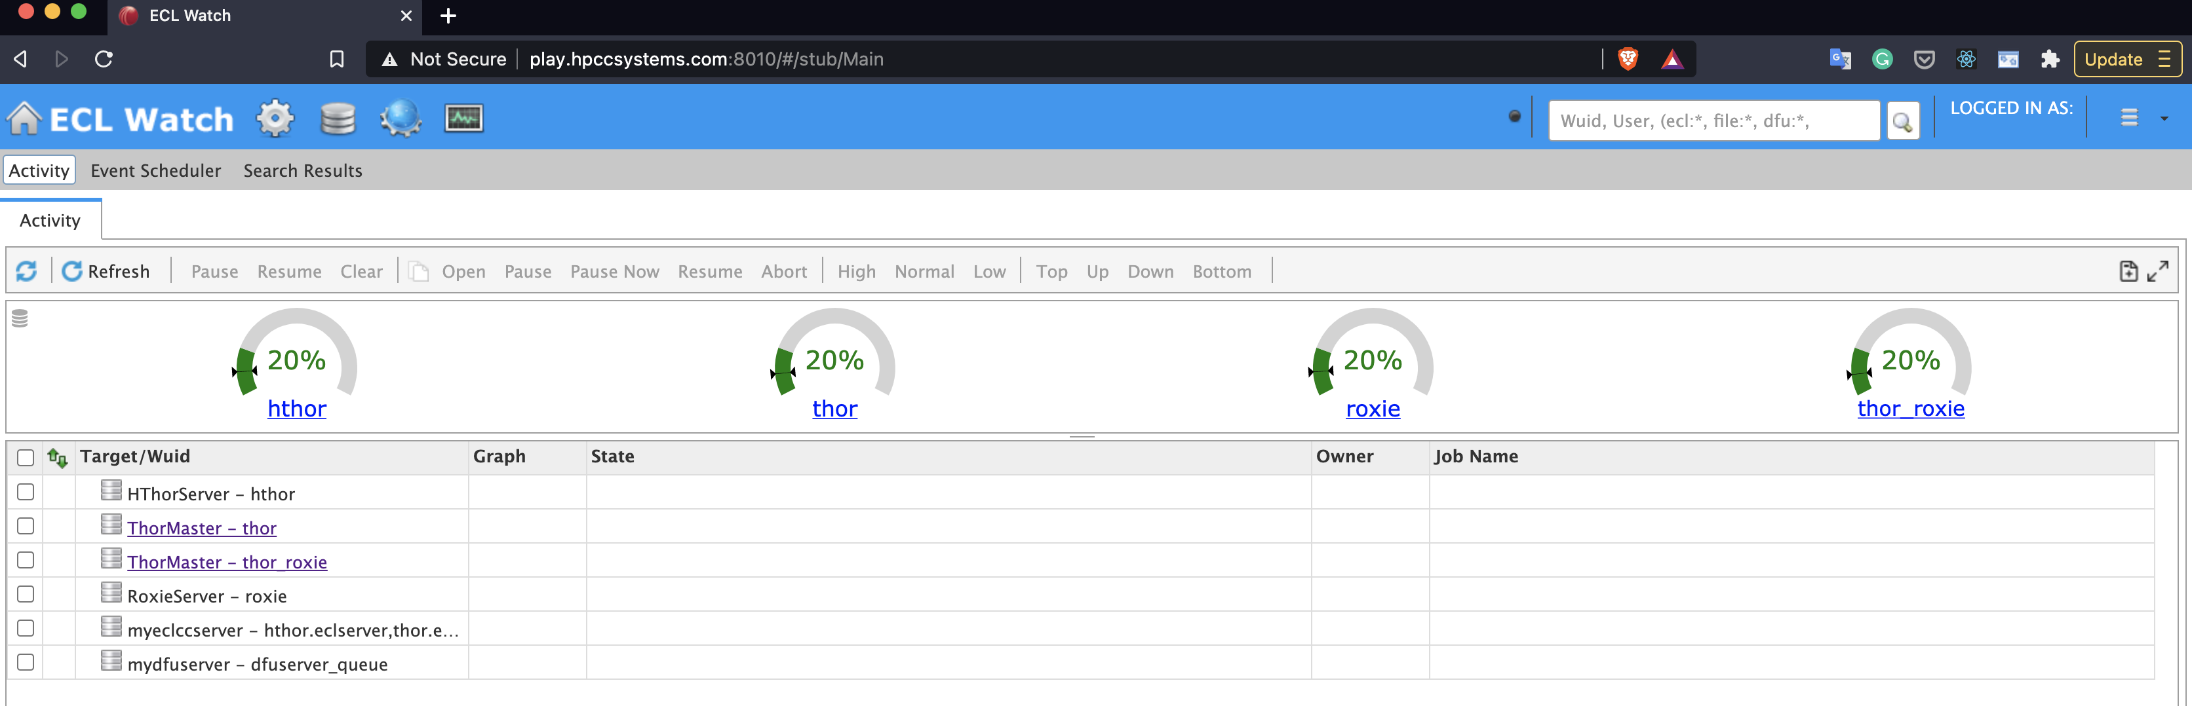
Files

Slide 44
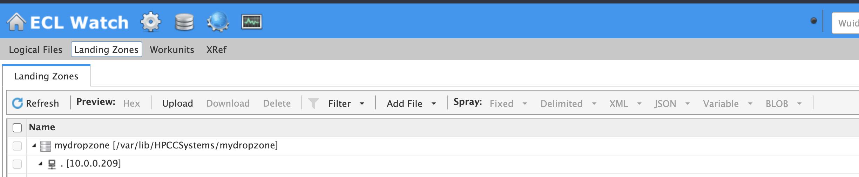
Landing Zone

Slide 45
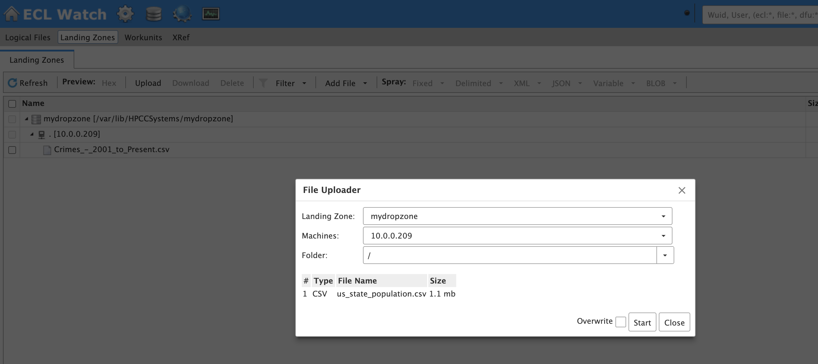
1) Upload
2) Select the population file
3) Making sure the Landing Zone IP is entered
4) Click the Start Button

Slide 46
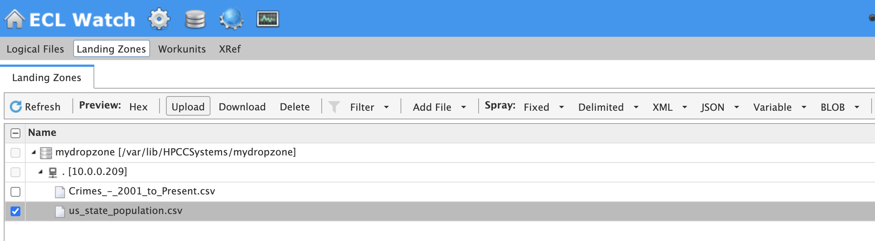
Select the File

Slide 47
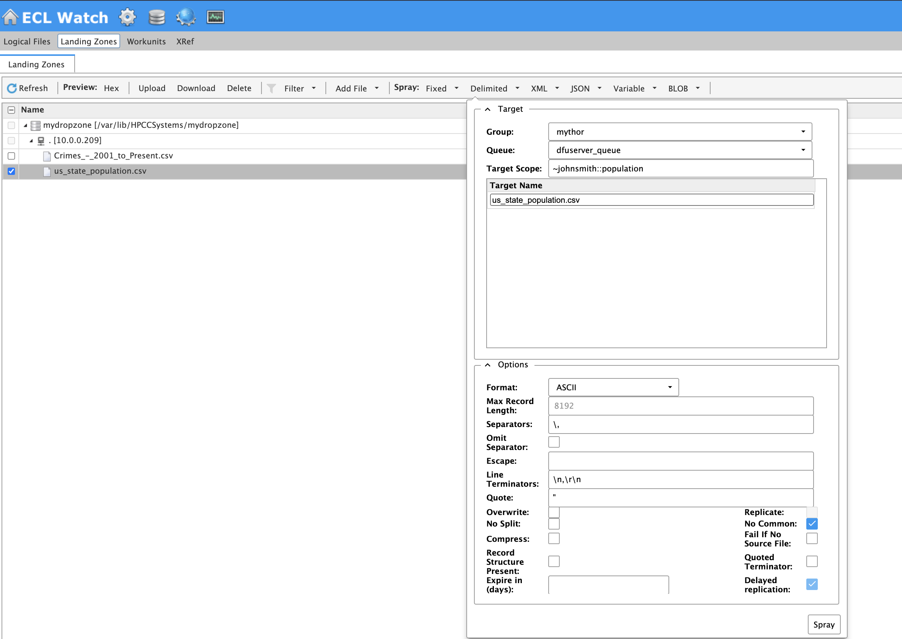
2) Click on Delimited
3) Modify the scope to ~yourname::population or anything that is appropriate
1) Select the File
4) Click on Spray

Slide 48
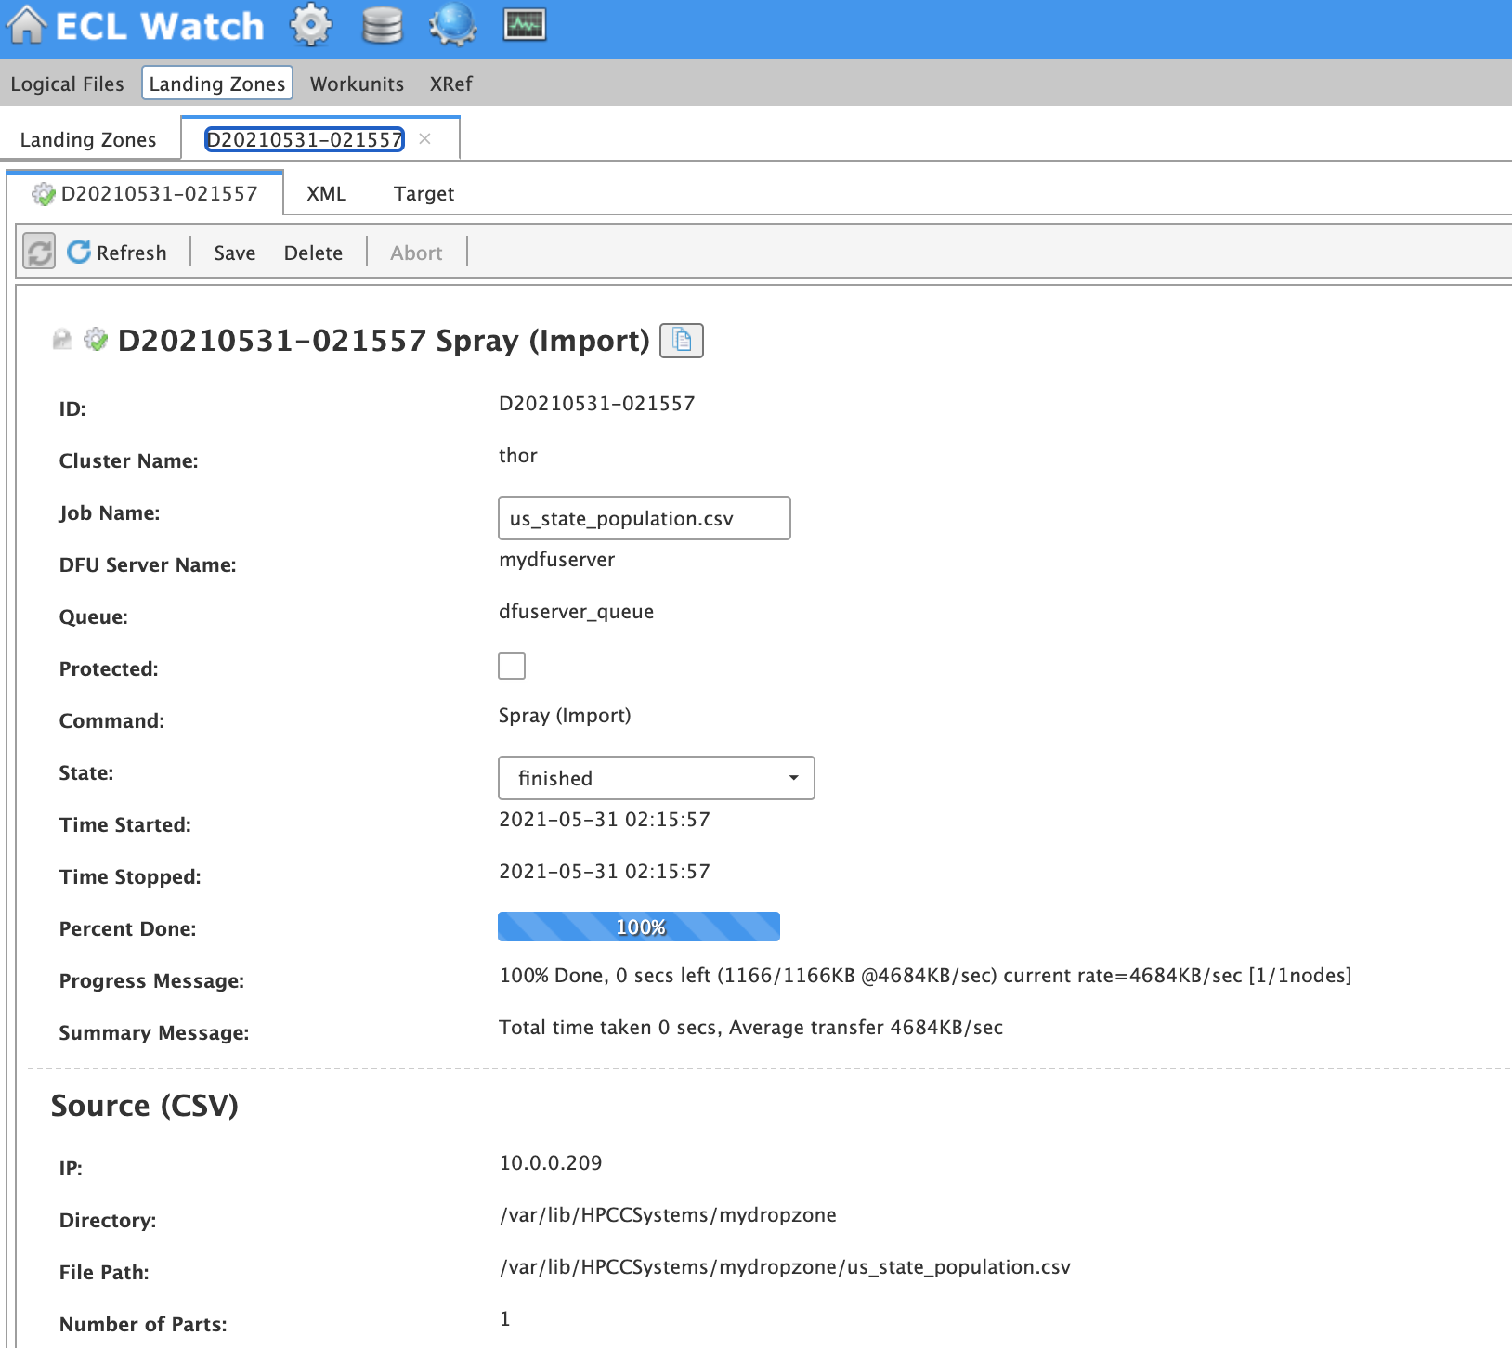

Slide 49
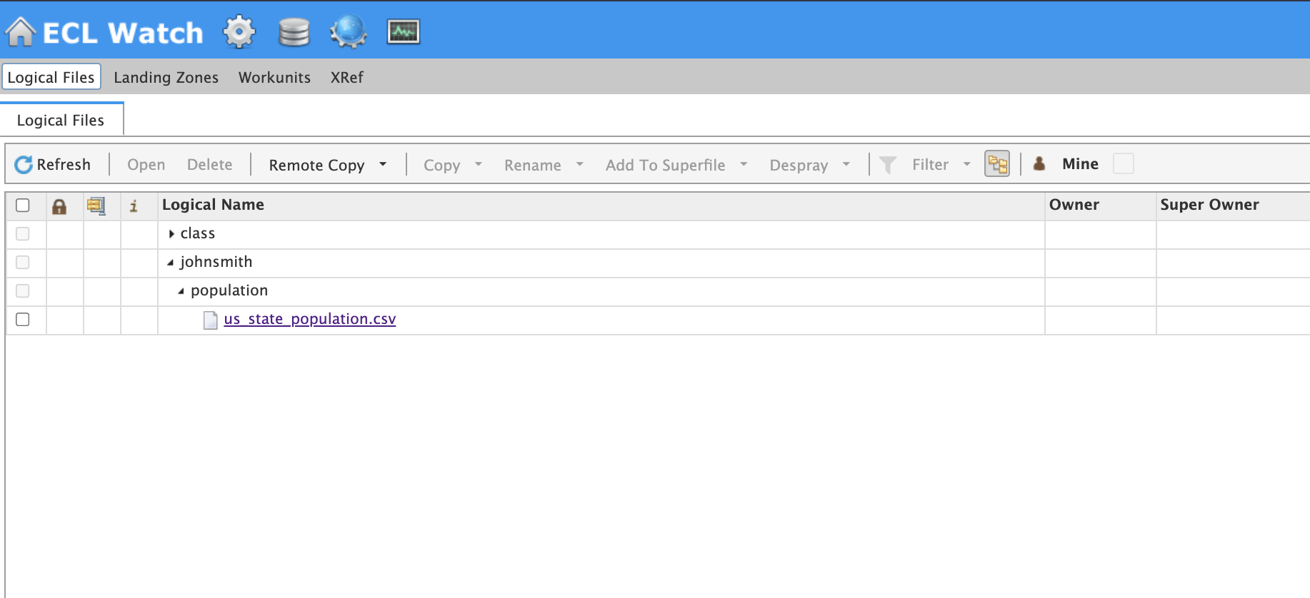
Logical File View
Scope View
Uploaded File

Slide 50
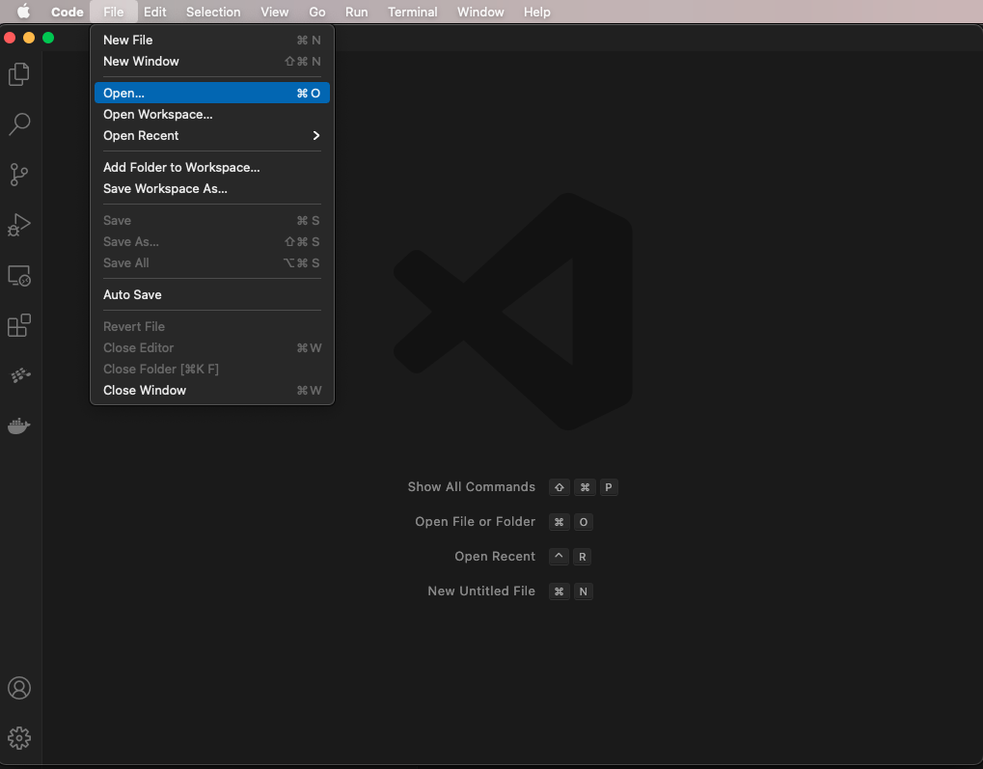

Slide 51
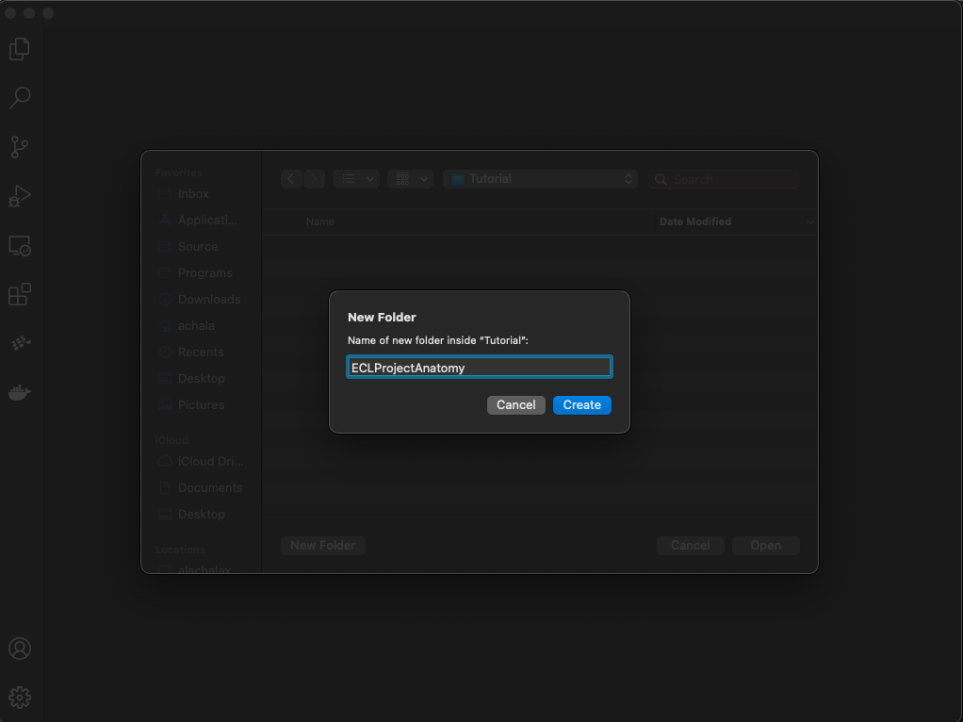

Slide 52
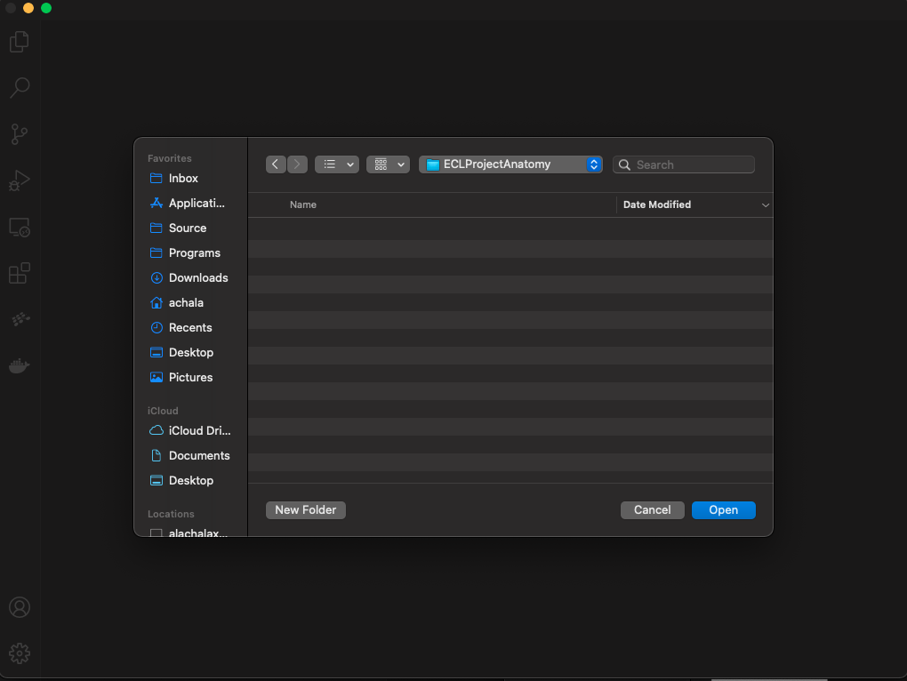

Slide 53
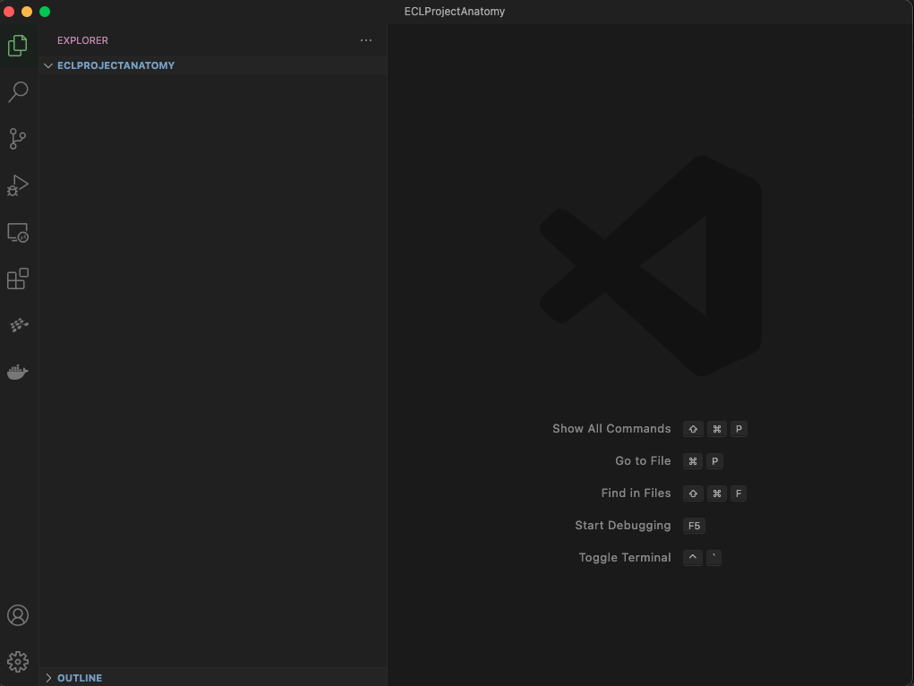

Slide 54
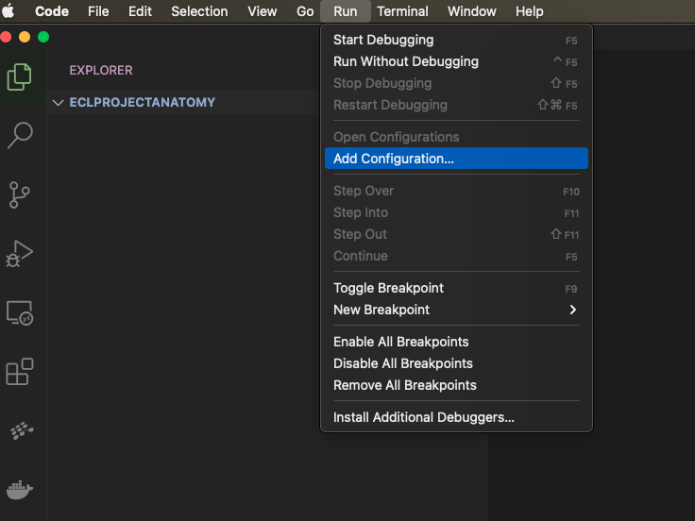

Slide 55
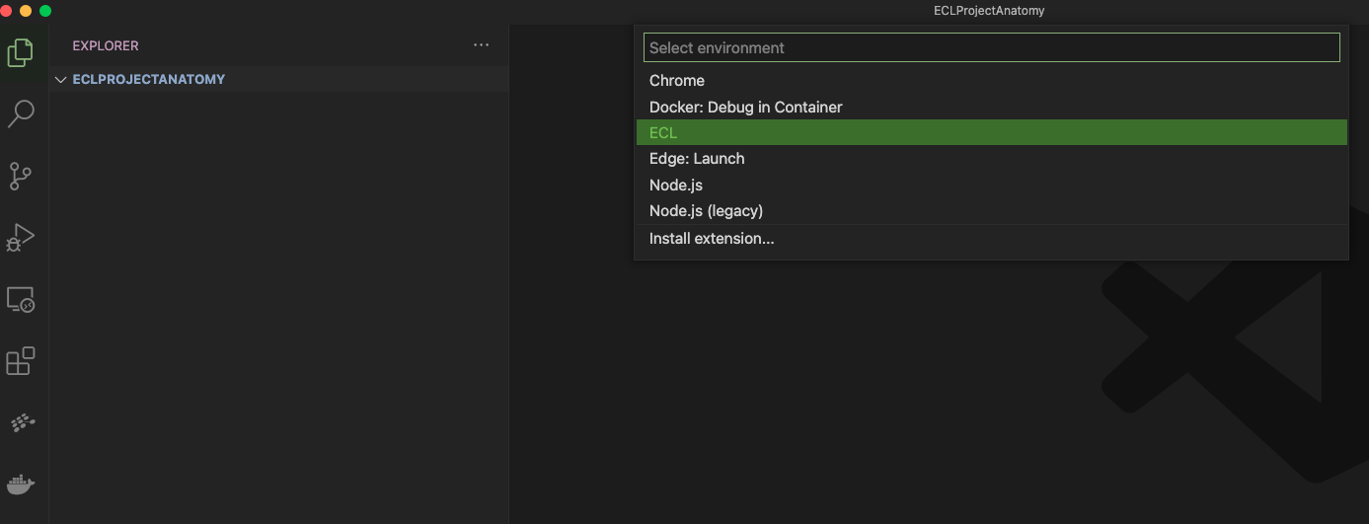

Slide 56
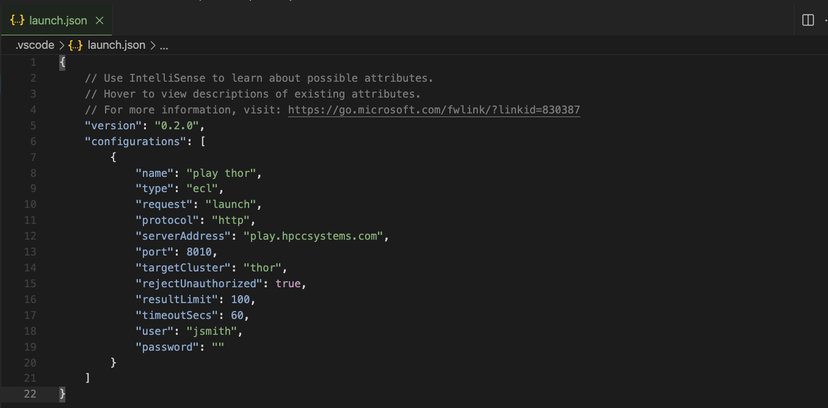
An Appropriate Name
The cluster DNS or IP
The login user and password for the cluster.
play.hpccsytems.com does not need a password
thor if the cluster being used is thor, roxie if the cluster being used is ROXIE

